Slide 1


Computer Networks X_400487
Lecture 3
Chapter 3: The Data Link Layer—Part 2
Lecturer: Jesse Donkervliet

Slide 2
Data Link Layer — Roadmap
Part 1
Framing
Flow Control
Guaranteed Delivery
Sliding Window Protocols
Part 2
Error detection
Error correction

Slide 3


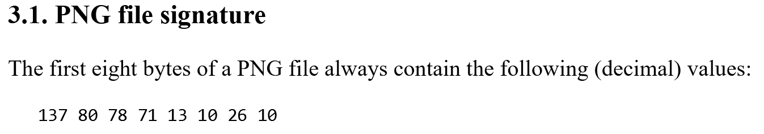



1 Gibibyte = $8×2^{30}$ bits
A single bit flip can break these images

Slide 4
Error Detection

Slide 5
Detecting errors in received frames
Q: What causes these bit flips?
Data at sender: 0111010101010111010001
Data at receiver: 0111010111010111010001
Somehow bit was flipped!

Slide 6
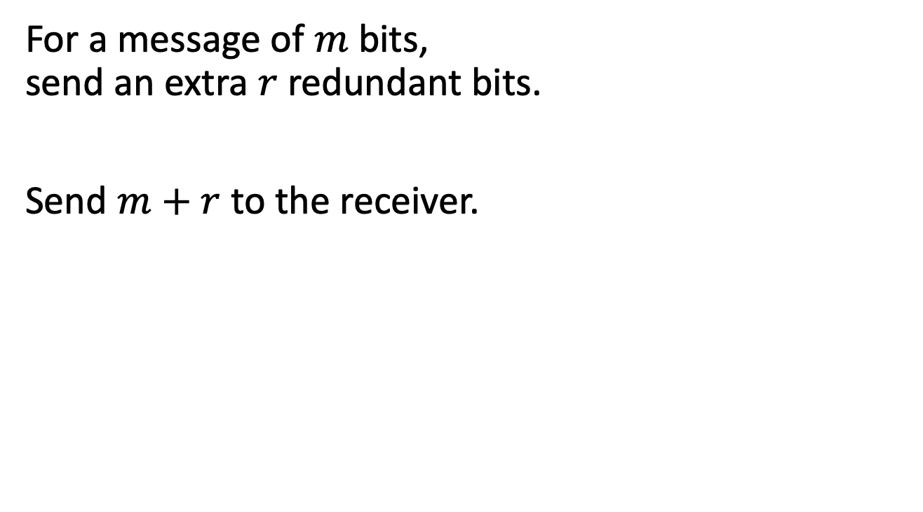
Adding redundant bits
For a message of $m$ bits, send an extra $r$ redundant bits.
Send $m+r$ to the receiver.
Systematic code
Data (m bits)
Check bits (r bits)
Codeword (m+r bits)

Slide 7
Hamming distance
Number of bits that differ between two bit strings.
10001001
10110001
Hamming distance 3.
110 111 101 001
Three bit flips required to change from one sequence to the other.
Adding redundant bits increases the distance between valid bit strings!

Slide 8
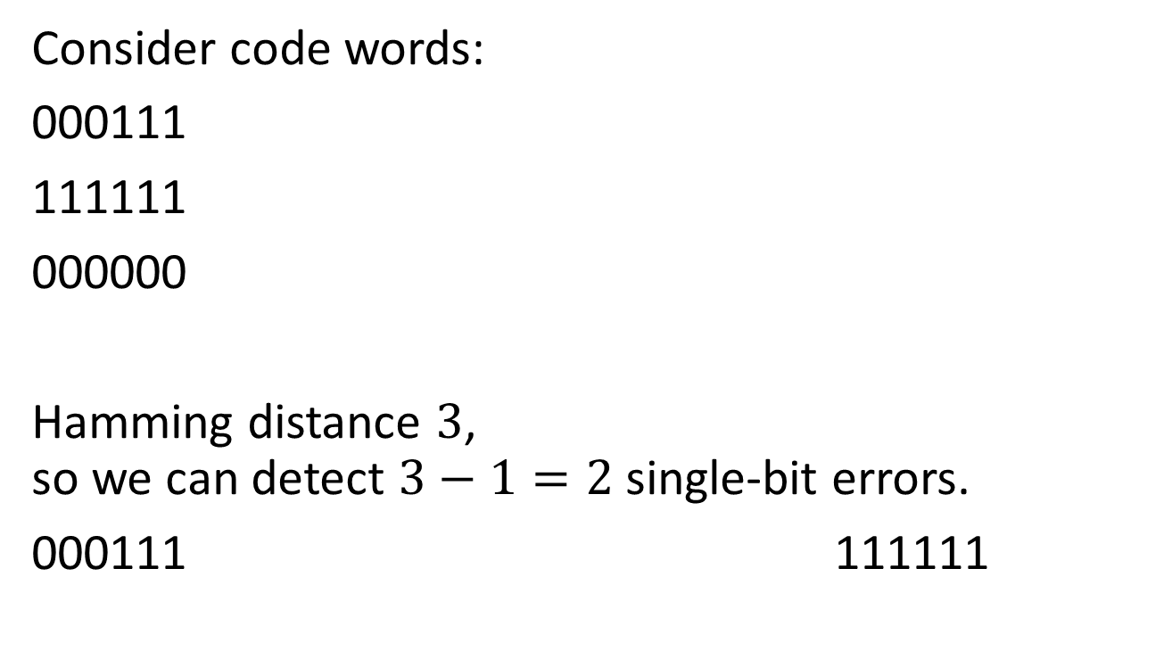
How many errors can we detect?
Consider code words:
000111
111111
000000
Hamming distance $3$, so we can detect $3−1=2$single-bit errors.
000111 111111
Q: How many single-bit errors can we detect?

Slide 9
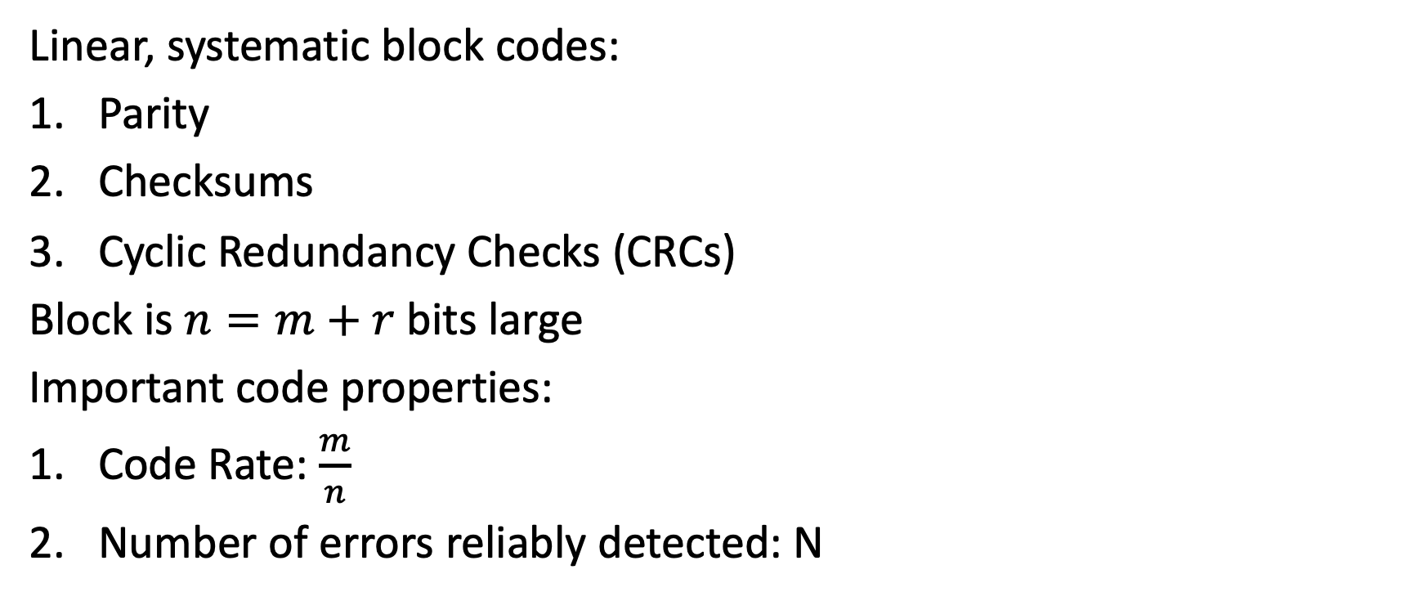
Error detection
Q: How to assess the quality of these codes?
Linear, systematic block codes:
Parity
Checksums
Cyclic Redundancy Checks (CRCs)
Block is $n=m+r$ bits large
Important code properties:
Code Rate: $\frac{m}{n}$
Number of errors reliably detected: N

Slide 10
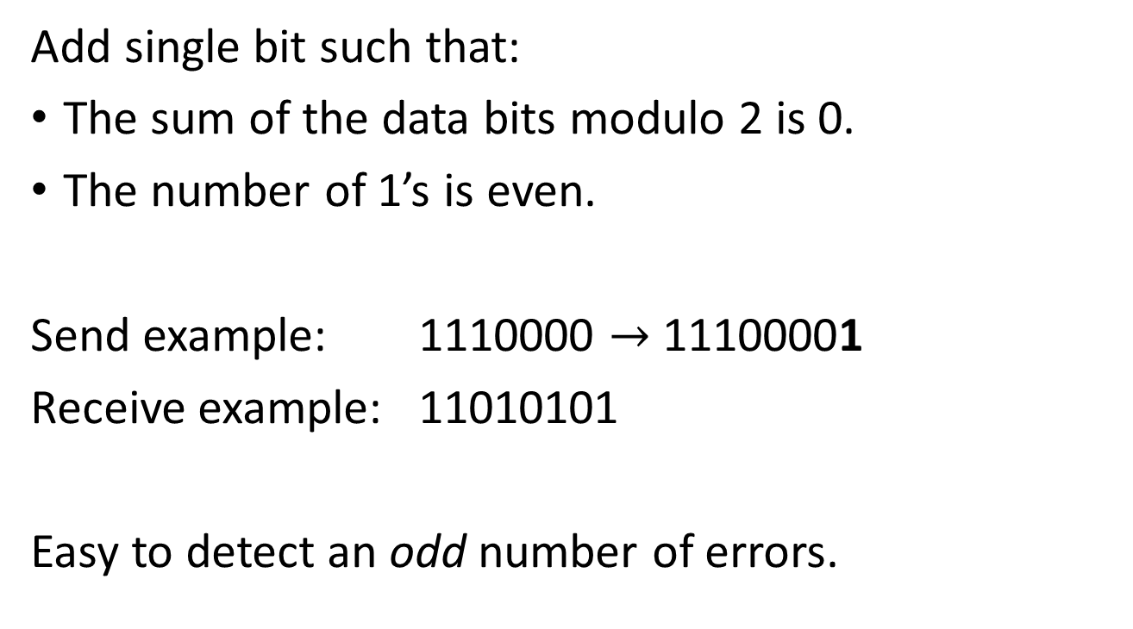
Parity
Q: How many bit errors can be detected?
Add single bit such that:
The sum of the data bits modulo 2 is 0.
The number of 1’s is even.
Send example: 1110000 $→$ 11100001
Receive example: 11010101
Easy to detect an odd number of errors.
Error detected!

Slide 11
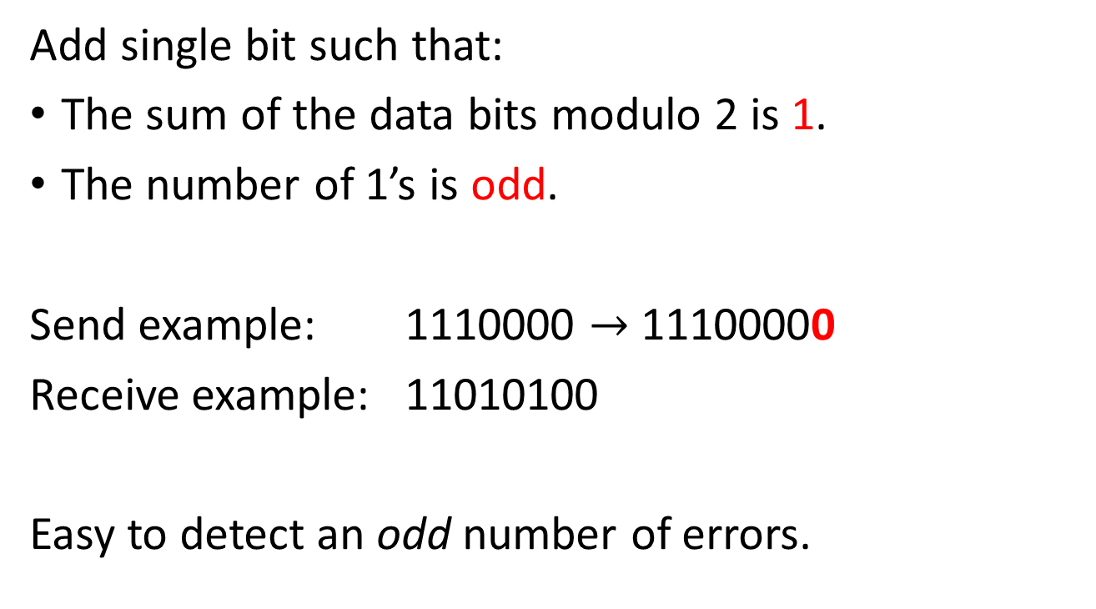
Parity
Q: How many bit errors can be detected?
Add single bit such that:
The sum of the data bits modulo 2 is 1.
The number of 1’s is odd.
Send example: 1110000 $→$ 11100000
Receive example: 11010100
Easy to detect an odd number of errors.
Error detected!

Slide 12
Multiple parity bits
transmit order
11100000010101110101001010001111000

Slide 13
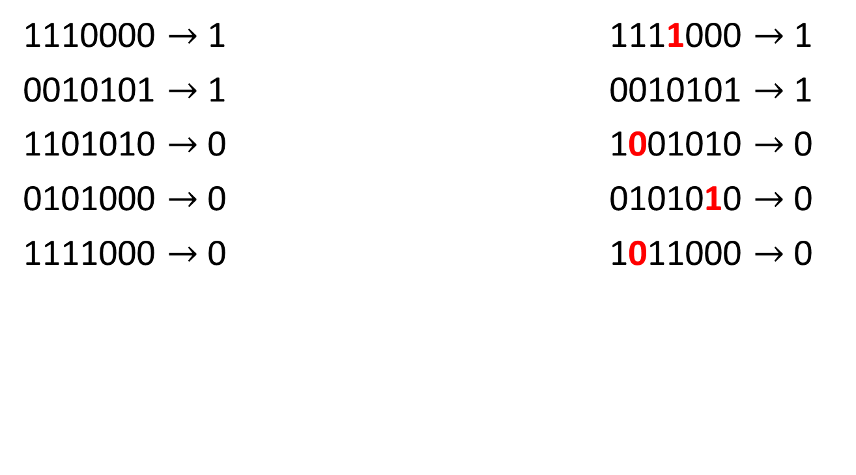
Multiple parity bits
transmit order
1110000 $→$ 1 1111000 $→$ 1
0010101 $→$ 1 0010101 $→$ 1
1101010 $→$ 0 1001010 $→$ 0
0101000 $→$ 0 0101010 $→$ 0
1111000 $→$ 0 1011000 $→$ 0
channel
Multiple single-bit errors detected.

Slide 14
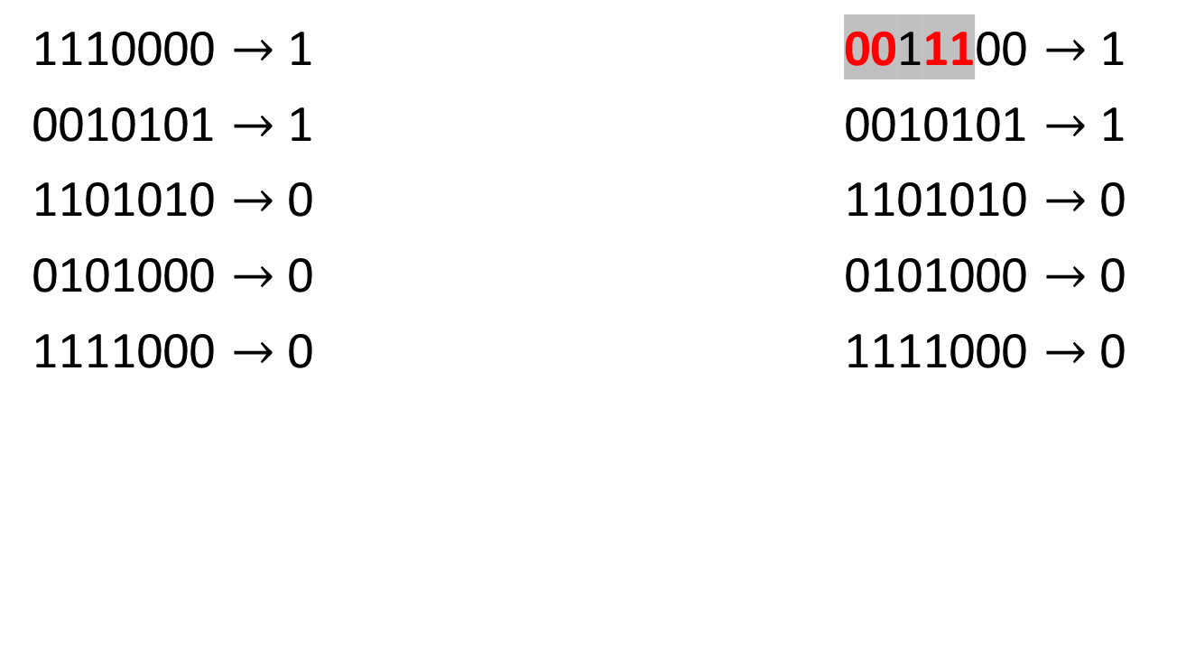
Burst errors
Burst error not detected!
transmit order
1110000 $→$ 1 0011100 $→$ 1
0010101 $→$ 1 0010101 $→$ 1
1101010 $→$ 0 1101010 $→$ 0
0101000 $→$ 0 0101000 $→$ 0
1111000 $→$ 0 1111000 $→$ 0
channel

Slide 15
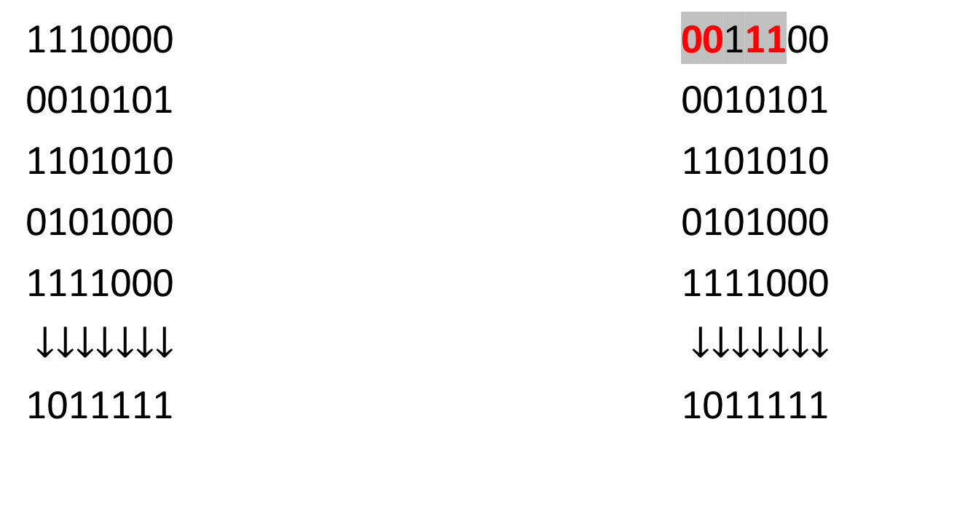
Burst errors
transmit order
1110000 0011100
0010101 0010101
1101010 1101010
0101000 0101000
1111000 1111000
$↓↓↓↓↓↓↓$ $↓↓↓↓↓↓↓$
1011111 1011111
channel
Burst error detected.

Slide 16
Checksums
Q: Disadvantages?
Checksum treats data as N-bit words and adds N check bits that are the modulo 2^{N} sum of the words.
Example: Internet 16-bit one’s complement checksum.
Properties:
Improved error detection over parity bits.
Detects bursts up to N errors.
Vulnerable to systematic errors, e.g., added zeros.

Slide 17
Checksum Example
add
00000000
11101000
----------- +
11101000
transmit order
11101000 00100101 11011010 01010000 11111000
Groups of 8 bits → calculate sum mod 256
Internet checksum uses one’s complement arithmetic

Slide 18
Checksum Example
transmit order
add
11101000
00100101
----------- +
100001101
11101000 00100101 11011010 01010000 11111000
Groups of 8 bits → calculate sum mod 256
(one’s complement arithmetic)
00001110
Internet checksum uses one’s complement arithmetic

Slide 19
Checksum Example
transmit order
11101000 00100101 11011010 01010000 11111000
Groups of 8 bits → calculate sum mod 256
add
00111001
11111000
----------- +
100110001
00110010
Internet checksum uses one’s complement arithmetic

Slide 20
Checksum Example
transmit order
11101000 00100101 11011010 01010000 11111000
Groups of 8 bits → calculate sum mod 256
add
00111001
11111000
----------- +
100110001
11001101
invert
00110010
Internet checksum uses one’s complement arithmetic

Slide 21
Checksum Example
transmit order
11101000 00100101 11011010 01010000 11111000
11101000 00100101 11011010 01010000 11111000
Groups of 8 bits → calculate sum mod 256
channel
11001101
11001101
(one’s complement arithmetic)
+
Q: Why do we get 0?
11111111 = 0 (no error)
Internet checksum uses one’s complement arithmetic

Slide 22
Checksum Example
transmit order
11101000 00100101 11011010 01010000 11111000
11100000 00100101 11111010 01011000 11111000
Groups of 8 bits → calculate sum mod 256
channel
11001101
10001101
(one’s complement arithmetic)
+
11011111 = 223 (error!)
Internet checksum uses one’s complement arithmetic

Slide 23
Checksum Example
transmit order
11101000 00100101 11011010 01010000 11111000
11101000 11011010 00100101 01010000 11111000
Groups of 8 bits → calculate sum mod 256
channel
11001101
11001101
(one’s complement arithmetic)
+
11111111 = 0 (no error)
Internet checksum uses one’s complement arithmetic

Slide 24
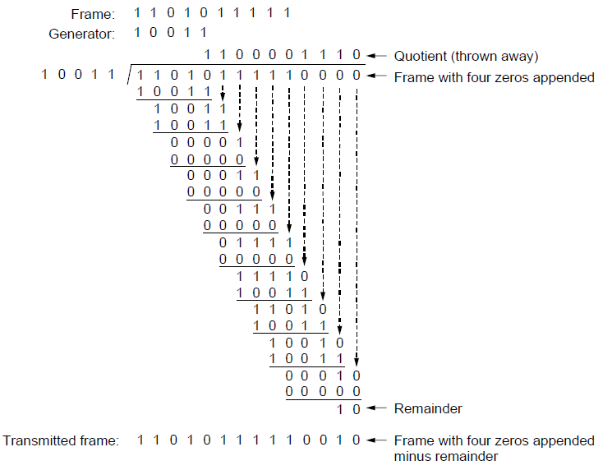
Cyclic Redundancy Check

Slide 25
Cyclic Redundancy Check The concept
message
check bits
code word
errors
0
generator polynomial

Slide 26
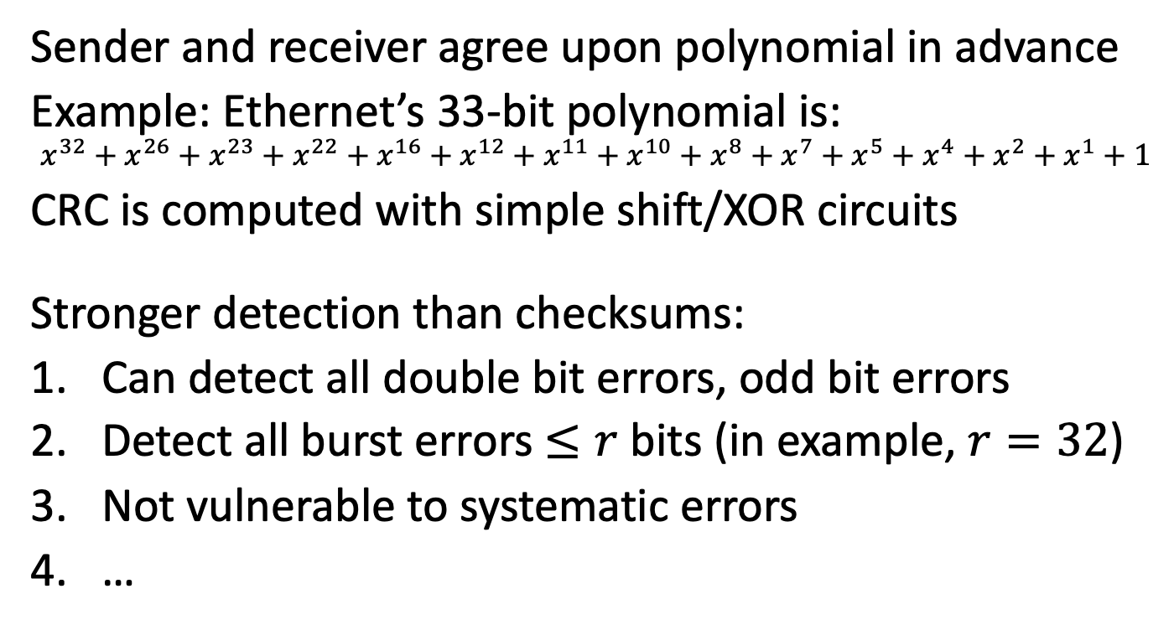
Cyclic Redundancy Check Properties and practice
Sender and receiver agree upon polynomial in advance
Example: Ethernet’s 33-bit polynomial is:
$$x^{32}+x^{26}+x^{23}+x^{22}+x^{16}+x^{12}+x^{11}+x^{10}+x^{8}+x^{7}+x^{5}+x^{4}+x^{2}+x^{1}+1$$
CRC is computed with simple shift/XOR circuits
Stronger detection than checksums:
Can detect all double bit errors, odd bit errors
Detect all burst errors $≤r$ bits (in example, $r=32$)
Not vulnerable to systematic errors
…
Because we use modulo 2 arithmetic.

Slide 27
Cyclic Redundancy Check

Slide 28
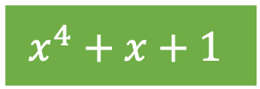
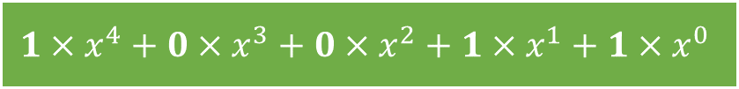
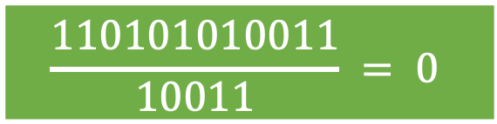
Cyclic Redundancy Check Example
Sender adds CRC
$${1×x}^{4}+0×x^{3}+0×x^{2}+1×x^{1}+1×x^{0}$$
0000
Modulo 2 arithmetic. No carries/borrows
message: 11010101
generator: 10011
1010000
10011
10000
10011
0011
Message: 11010101, CRC: 0011, Codeword: 110101010011
1001
Q: Consequences for implementation?
$$x^{4}+x+1$$
$$\frac{110101010011}{10011} = 0$$

Slide 29
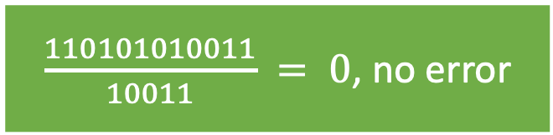
Cyclic Redundancy Check Example
Receiver checks for errors
0011
message: 11010101
generator: 10011
1010011
10011
10011
10011
0
Message: 11010101, CRC: 0011, Codeword: 110101010011
1001
$\frac{110101010011}{10011} = 0$, no error

Slide 30
Error Correction

Slide 31
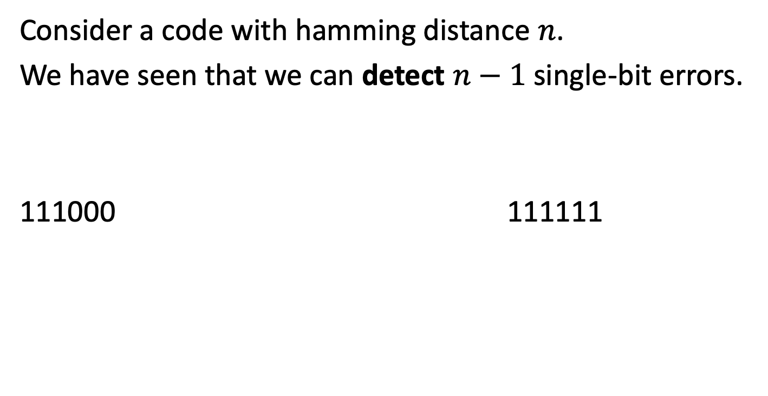
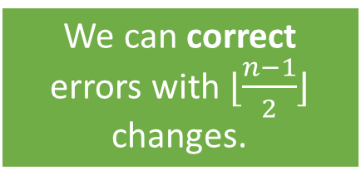
How many errors can we correct?
Consider a code with hamming distance $n$.
We have seen that we can detect $n−1$ single-bit errors.
111000 111111
But it could have been this value!
If we receive this value, …
… we assume it should be this value.
Q: What assumption do we need for this approach to work in practice?
We can correct errors with $⌊\frac{n−1}{2}⌋$ changes.
Conputer Nrtworls

Slide 32
Error correction
Hamming codes
Binary convolutional codes
Reed-Solomon codes
Low-Density Parity Check codes
… (many others)

Slide 33
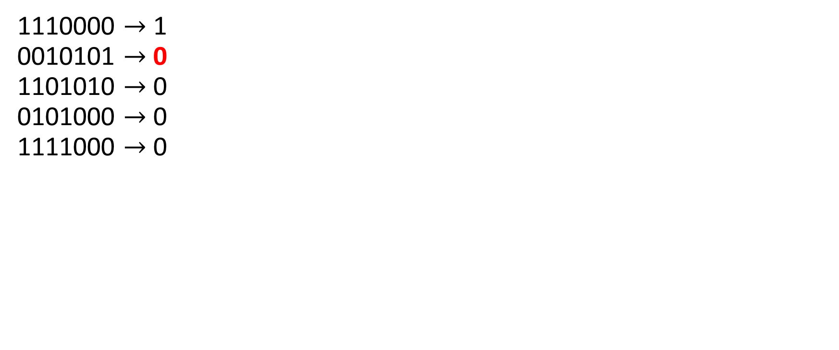
Multiple parity bits
receive order
1110000 $→$ 1 0010101 $→$ 0 1101010 $→$ 0 0101000 $→$ 0 1111000 $→$ 0
Error in second row!

Slide 34
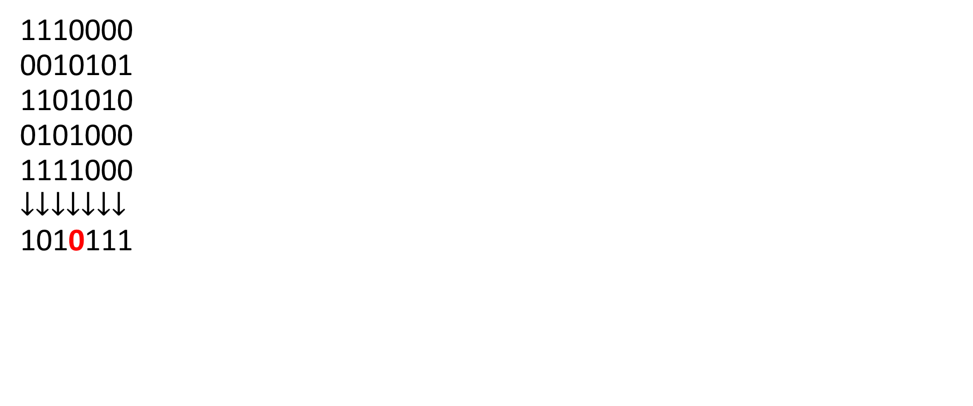
Multiple parity bits
receive order
1110000 0010101 1101010 0101000 1111000 $$↓↓↓↓↓↓↓$$ 1010111
Error in fourth column!

Slide 35
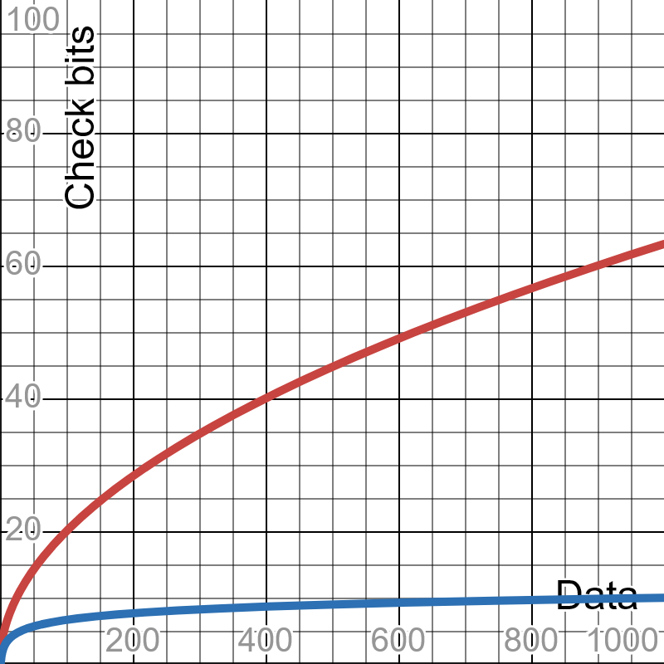
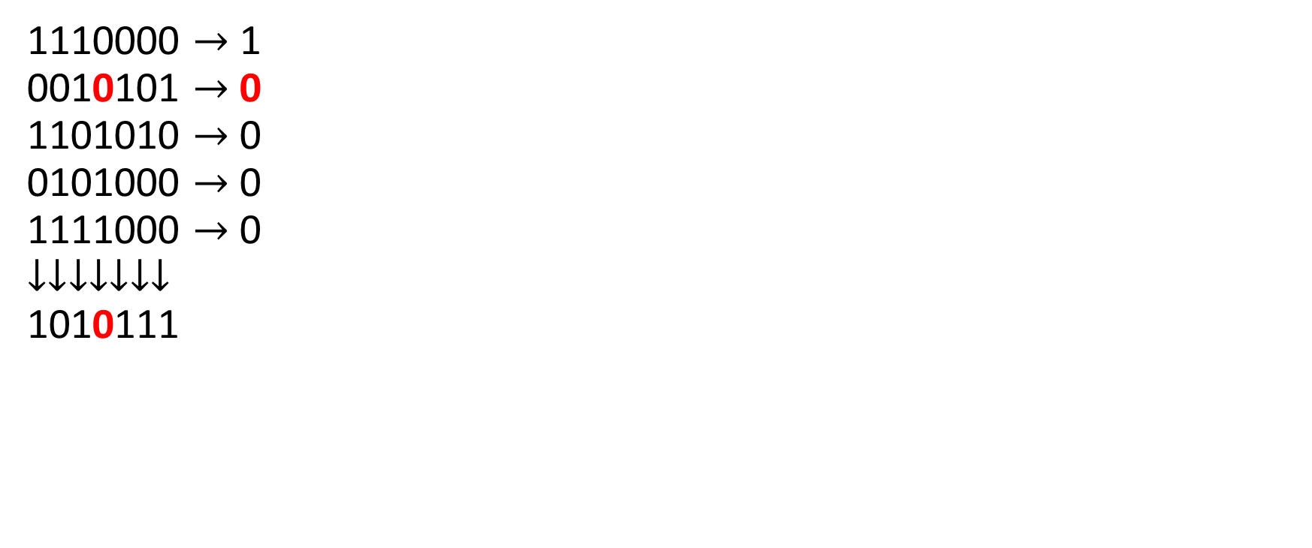
Multiple parity bits
= Row+column parity bits
= Hamming code
receive order
1110000 $→$ 1 0010101 $→$ 0 1101010 $→$ 0 0101000 $→$ 0 1111000 $→$ 0 $$↓↓↓↓↓↓↓$$ 1010111
Error located!

Slide 36
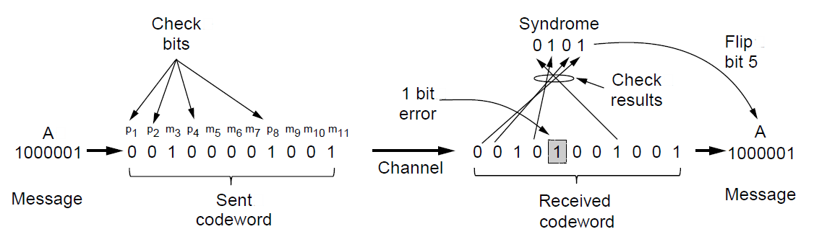
Hamming codes
Minimum number of check bits such that all 1-bit errors can be corrected!
Example of an (11, 7) Hamming code correcting a single-bit error.

Slide 37
Hamming codes An example
Use bit-locations that are a power of 2 as check bits. Use the remaining positions for the message.
message: 11010101
codeword: __1_101_0101
positions: 123456789…

Slide 38
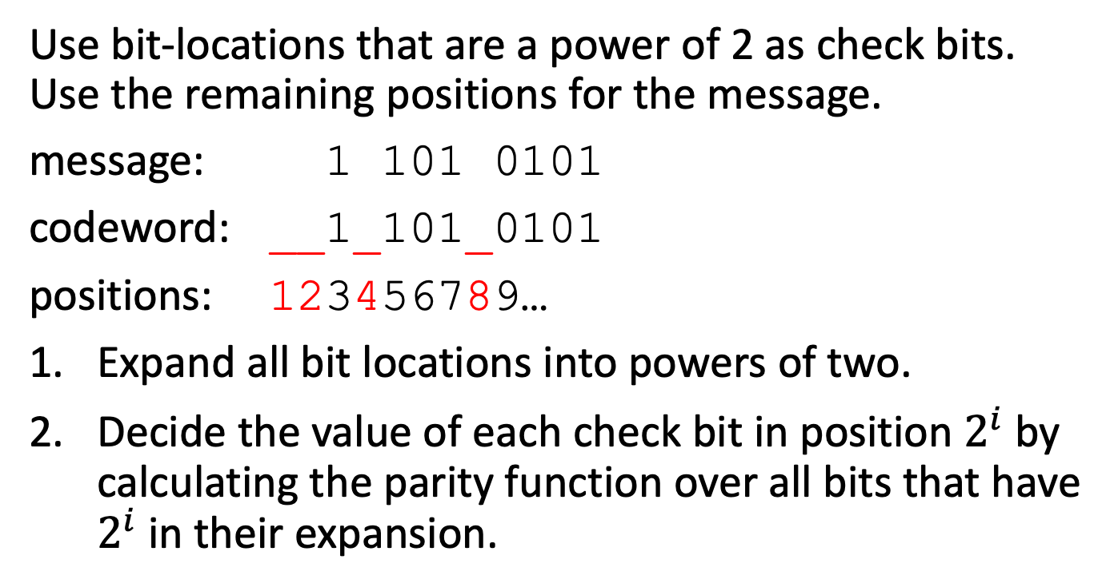
Hamming codes An example
Use bit-locations that are a power of 2 as check bits. Use the remaining positions for the message.
message: 1 101 0101
codeword: __1_101_0101
positions: 123456789…
Expand all bit locations into powers of two.
Decide the value of each check bit in position $2^{i}$ by calculating the parity function over all bits that have $2^{i}$in their expansion.

Slide 39
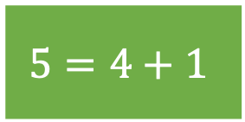
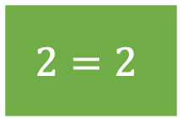
Hamming codes An example
1. Expand all bit locations into powers of two.
The check bit positions
$$2=2$$
$$5=4+1$$
All bit positions
 | 1 | 2 | 3 | 4 | 5 | 6 | 7 | 8
 | 0001 | 0010 | 0011 | 0100 | 0101 | 0110 | 0111 | 1000
1 |  |  |  |  | X
2 |  | X
4 |  |  |  |  | X
8

Slide 40
Hamming codes An example
1. Expand all bit locations into powers of two.
$$2=2$$
$$5=4+1$$
 | 1 | 2 | 3 | 4 | 5 | 6 | 7 | 8
 | 0001 | 0010 | 0011 | 0100 | 0101 | 0110 | 0111 | 1000
1 | X |  | X |  | X |  | X
2 |  | X | X |  |  | X | X
4 |  |  |  | X | X | X | X
8 |  |  |  |  |  |  |  | X

Slide 41
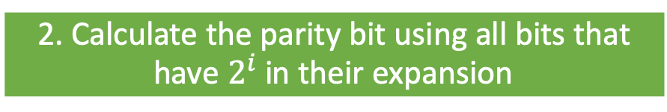
Hamming codes An example
2. Calculate the parity bit using all bits that have $2^{i}$in their expansion
Check bit 1 is a parity bit calculated using bits 1, 3, 5, and 7
Check bit 4 is a parity bit calculated using bits 4, 5, 6, and 7
 | 1 | 2 | 3 | 4 | 5 | 6 | 7 | 8
 | 0001 | 0010 | 0011 | 0100 | 0101 | 0110 | 0111 | 1000
1 | X |  | X |  | X |  | X
2 |  | X | X |  |  | X | X
4 |  |  |  | X | X | X | X
8 |  |  |  |  |  |  |  | X

Slide 42
Hamming codes An example
2. Calculate the parity bit using all bits that have $2^{i}$in their expansion
Use bit-locations that are a power of 2 as check bits. Use the remaining positions for the message.
message: 1 101 0101
codeword: __1_101_0101
positions: 123456789…
Position 1+2
Position 4
Position 4+2+1

Slide 43
Hamming codes An example
Use bit-locations that are a power of 2 as check bits. Use the remaining positions for the message.
message: 1 101 0101
codeword: __1_101_0101
positions: 123456789…

Slide 44
Hamming codes An example
Use bit-locations that are a power of 2 as check bits. Use the remaining positions for the message.
message: 1 101 0101
codeword: 1_1_101_0101
positions: 123456789…

Slide 45
Hamming codes An example
Use bit-locations that are a power of 2 as check bits. Use the remaining positions for the message.
message: 1 101 0101
codeword: 1_1_101_0101
positions: 123456789…

Slide 46
Hamming codes An example
Use bit-locations that are a power of 2 as check bits. Use the remaining positions for the message.
message: 1 101 0101
codeword: 111_101_0101
positions: 123456789…

Slide 47
Hamming codes An example
Use bit-locations that are a power of 2 as check bits. Use the remaining positions for the message.
message: 1 101 0101
codeword: 111110100101
positions: 123456789…

Slide 48
Hamming codes Error correction
Use bit-locations that are a power of 2 as check bits. Use the remaining positions for the message.
message: 1 101 0101
codeword: 111111100101
positions: 123456789…
Computer error syndrome:
Check bit 1 = parity of bits 1, 3, 5, 7, 9, 11
Single-bit error

Slide 49
Hamming codes Error correction
Use bit-locations that are a power of 2 as check bits. Use the remaining positions for the message.
message: 1 101 0101
codeword: 111111100101
positions: 123456789…
Computer error syndrome:
Check bit 1 = parity of bits 1, 3, 5, 7, 9, 11 = 0
Single-bit error

Slide 50
Hamming codes Error correction
Use bit-locations that are a power of 2 as check bits. Use the remaining positions for the message.
message: 1 101 0101
codeword: 111111100101
positions: 123456789…
Computer error syndrome:
Check bit 1 = parity of bits 1, 3, 5, 7, 9, 11 = 0
Check bit 2 = parity of bits 2, 3, 6, 7, 10, 11 = 1
Single-bit error

Slide 51
Hamming codes Error correction
Use bit-locations that are a power of 2 as check bits. Use the remaining positions for the message.
message: 1 101 0101
codeword: 111111100101
positions: 123456789…
Computer error syndrome:
Check bit 1 = parity of bits 1, 3, 5, 7, 9, 11 = 0
Check bit 2 = parity of bits 2, 3, 6, 7, 10, 11 = 1
Check bit 4 = parity of bits 4, 5, 6, 7, 12 = 1
Single-bit error
Error at location:
110 (binary)

Slide 52
Hamming codes Error correction
Use bit-locations that are a power of 2 as check bits. Use the remaining positions for the message.
message: 1 101 0101
codeword: 111111100101
positions: 123456789…
Computer error syndrome:
Check bit 1 = parity of bits 1, 3, 5, 7, 9, 11 = 0
Check bit 2 = parity of bits 2, 3, 6, 7, 10, 11 = 1
Check bit 4 = parity of bits 4, 5, 6, 7, 12 = 1
Single-bit error
Error at location:
110 (binary)

Slide 53
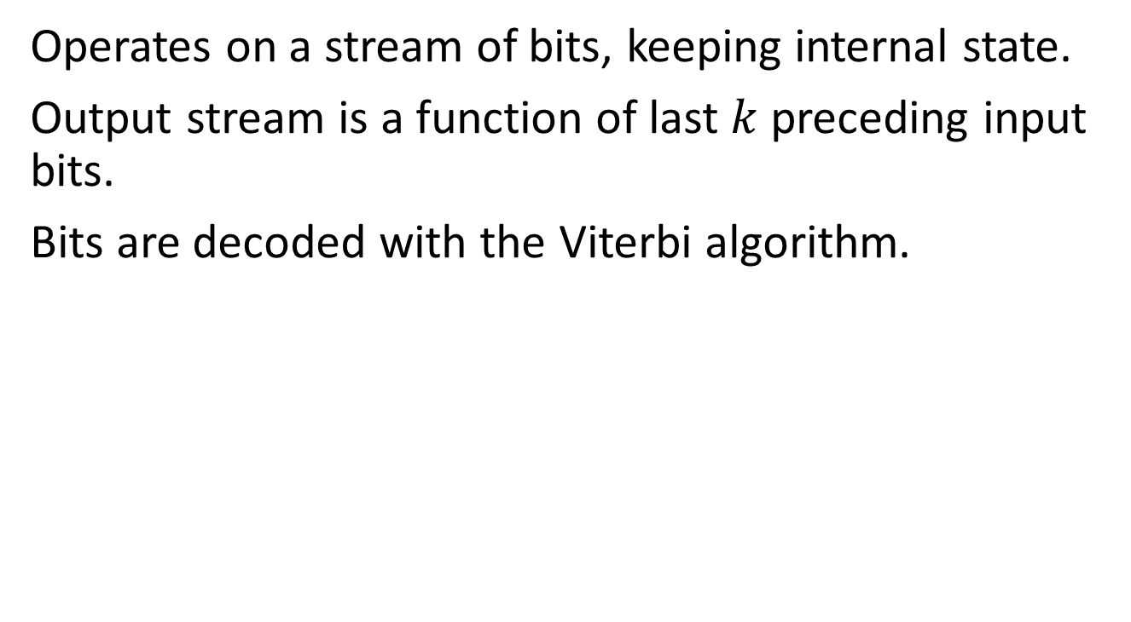
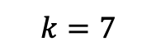
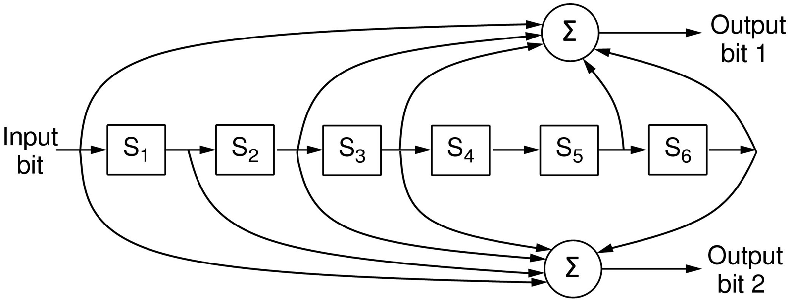
Convolutional codes
Different from systematic codes and block codes
Operates on a stream of bits, keeping internal state.
Output stream is a function of last $k$ preceding input bits.
Bits are decoded with the Viterbi algorithm.
Determines most likely input for given output.
… 1 1 1
…
0 1 1
1 0 1
$$k=7$$
Popular NASA binary convolutional code (rate = ½) used in 802.11

Slide 54
Shift registers. Can be initialized with other values
0
0
0
0
0
0
Input
Message

Slide 55


Message: 1 0 1 Code: …
Output bit 2
$$∑$$
0
0
0
0
0
0
Input
Message
$$∑$$
Output bit 1

Slide 56
Message: 1 0 1 Code: 11…
1+0+0+0+0 = 1
Output bit 2
$$∑$$
1
0
0
0
0
0
0
Input
Message
$$∑$$
Output bit 1
1+0+0+0+0 = 1

Slide 57
Message: 1 0 1 Code: 1101…
0+0+0+0+0 = 0
Output bit 1
$$∑$$
0
1
0
0
0
0
0
Input
Message
$$∑$$
Output bit 2
0+1+0+0+0 = 1

Slide 58
Message: 1 0 1 Code: 110100
1+1+0+0+0 = 0
Output bit 2
$$∑$$
1
0
1
0
0
0
0
Input
Message
$$∑$$
Q: Are we done dealing with errors?
Output bit 1
1+0+1+0+0 = 0

Slide 59
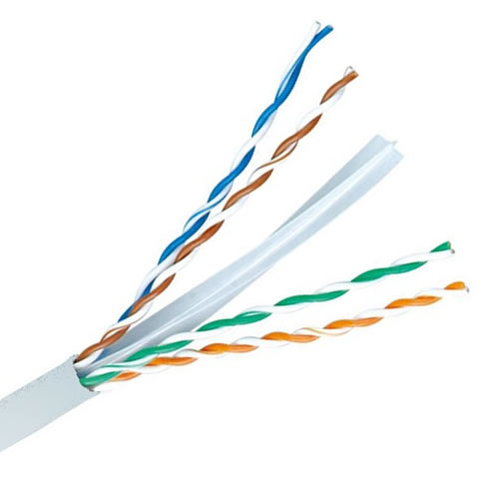
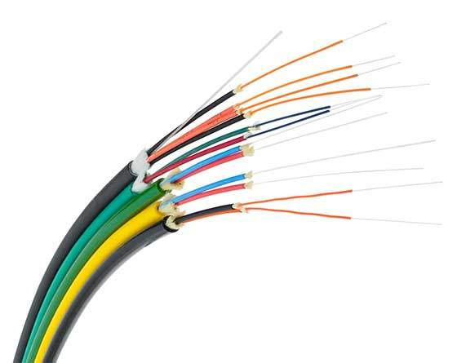
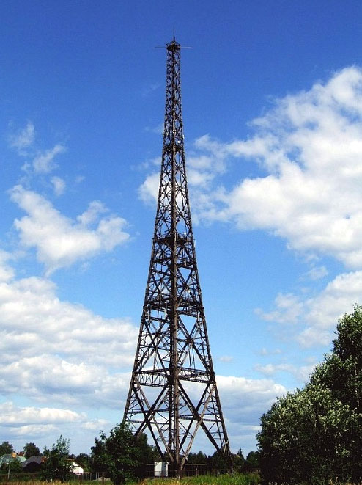
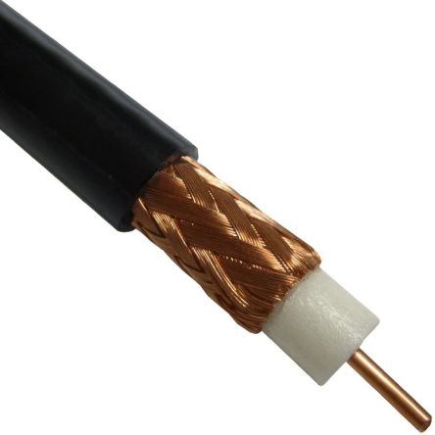
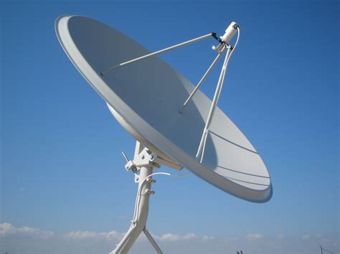




Data Link Layer Summary
A1: It depends on the physical medium
Framing (byte stuffing, bit stuffing, etc)
Guaranteed delivery
Sequence numbers, acknowledgments, and retransmissions
Flow control
Stop-and-Wait
Sliding Window
Error control
Detection (e.g., Parity bit, Checksum, CRC, …)
Correction (e.g., Hamming Code, Convolutional Code, …)
A2: It depends on the application
Q: When needed?
Q: When needed?
A3: We may want to address the problem in a higher layer
Q: Can you think of an example?
Q: When needed?

